Slide 1

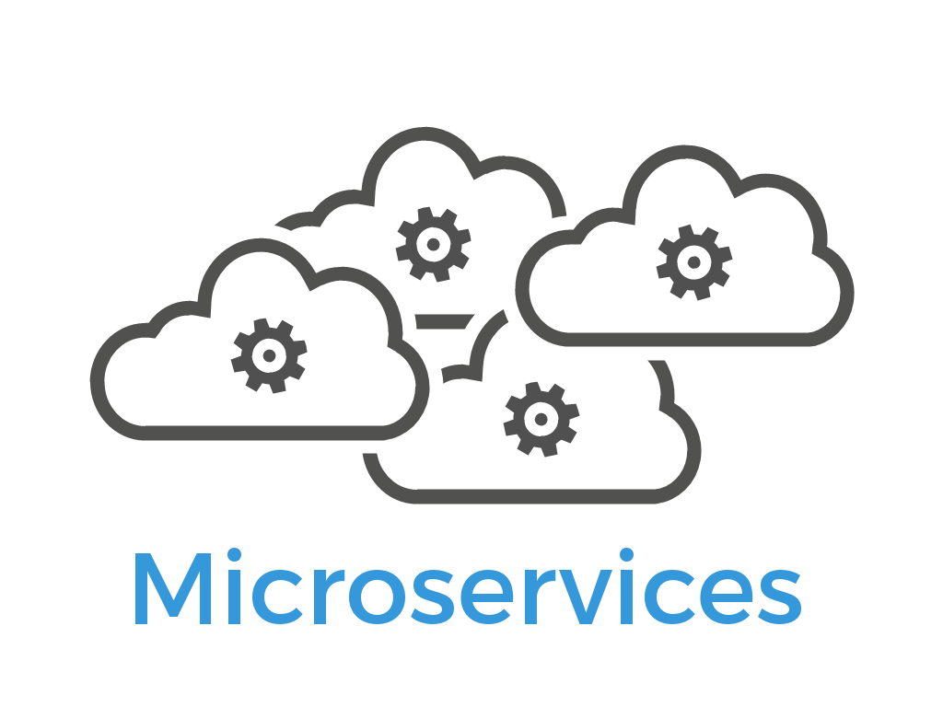

Microservices – Getting Started
Nikhil Shah

Slide 2


Slide 3


Slide 4
With increasing business demands, we now develop very large and complex projects that take more time to build and deploy.
Whenever QA reports any issue, we need to debug or fix it and then deploy the whole code.
To reduce these complexities, most organizations are moving towards Microservices development and Docker for easy deployment and smooth service running.

Slide 5
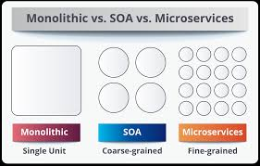

Slide 6


Slide 7
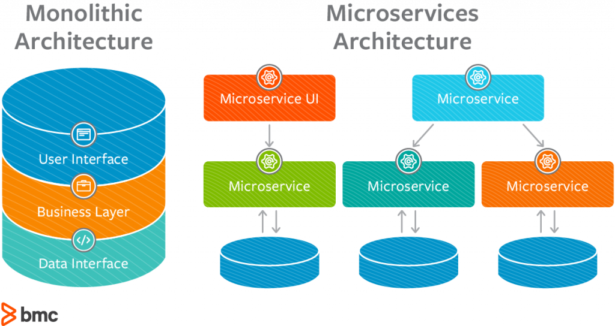

Slide 8
WHY SHOULD WE USE MICROSERVICES INSTEAD OF A MONOLITHIC APPROACH?
Microservices are smaller in size
Microservices are easier to develop, deploy, and debug, because a fix only needs to be deployed onto the microservice with the bug, instead of across the board
Microservices can be scaled quickly and can be reused among different projects
Microservices work well with containers like Docker
Microservices are independent of each other, meaning that if one of the microservices goes down, there is little risk of the full application shutting down

Slide 9
WHY SHOULD WE USE DOCKER?
Docker is a tool that makes it easier to create, deploy, and run applications by using a containerization approach.
These containers are lightweight and take less time to start than traditional servers.
These containers also increase performance and lower cost, while offering proper resource management.
Another benefit to using Docker is that you no longer need to pre-allocate RAM to each container.

Slide 10
Definition
A microservices architecture consists of a collection of small, autonomous services. Each service is self-contained and should implement a single business capability.

Slide 11
Characteristics of a Microservice
Services are small, independent, and loosely coupled.
Each service is a separate codebase.
Services can be deployed independently.
Services are responsible for persisting their own data or external state.
Services communicate with each other by using well-defined APIs.
Services don't need to share the same technology stack, libraries, or frameworks.
Notes:
In a microservices architecture, services are small, independent, and loosely coupled.
Each service is a separate codebase, which can be managed by a small development team.
Services can be deployed independently. A team can update an existing service without rebuilding and redeploying the entire application.
Services are responsible for persisting their own data or external state. This differs from the traditional model, where a separate data layer handles data persistence.
Services communicate with each other by using well-defined APIs. Internal implementation details of each service are hidden from other services.
Services don't need to share the same technology stack, libraries, or frameworks.

Slide 12
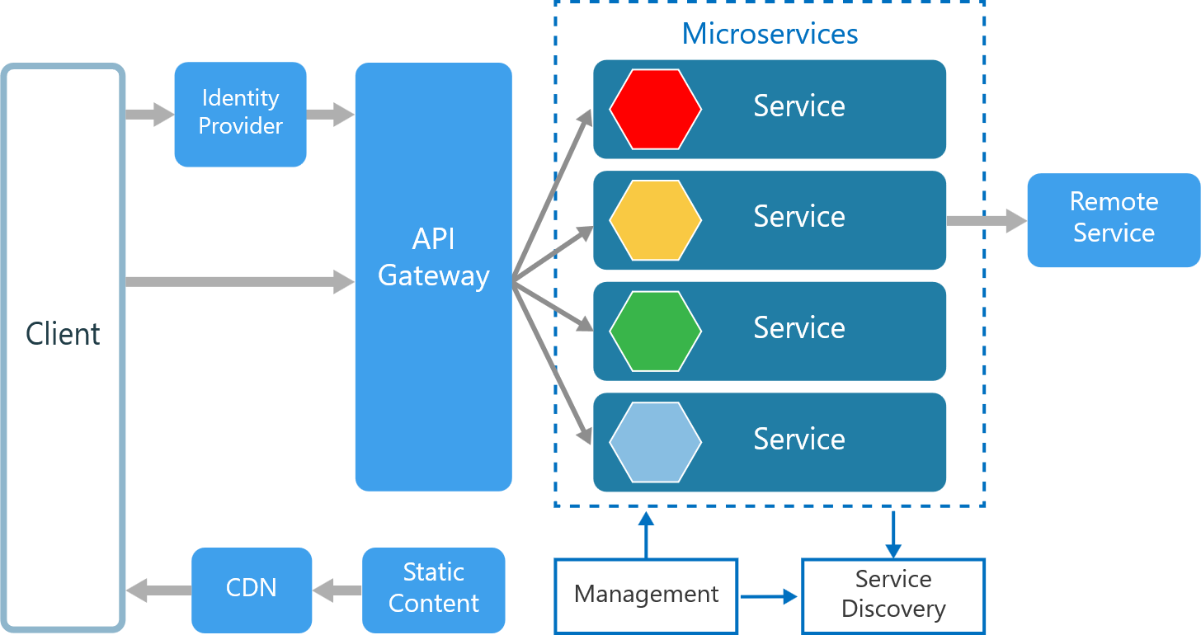
Microservices Overview

Slide 13
Other Components in a Typical Microservices Architecture
Management
Service Discovery
API Gateway
Notes:
Management. The management component is responsible for placing services on nodes, identifying failures, rebalancing services across nodes, and so forth.+
Service Discovery. Maintains a list of services and which nodes they are located on. Enables service lookup to find the endpoint for a service.
API Gateway. The API gateway is the entry point for clients. Clients don't call services directly. Instead, they call the API gateway, which forwards the call to the appropriate services on the back end. The API gateway might aggregate the responses from several services and return the aggregated response.

Slide 14
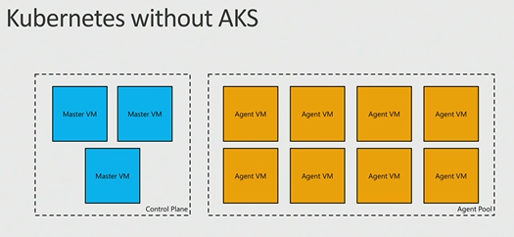
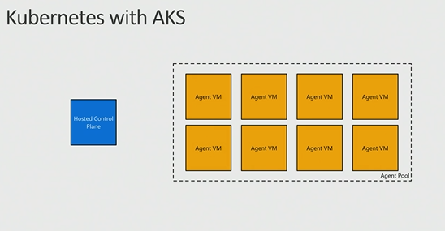
AKS: Managed Kubernetes
Azure-hosted control plane
  No master nodes to manage or pay for
Automated upgrades and patching
  Easily upgrade control plane and worker nodes to new versions of Kubernetes
Scale agent pool to increase or decrease capacity
Linux: Preview
Windows: Not yet
Notes:
Automatic binpacking
Self-healing
Horizontal scaling
Service discovery and load balancing
Automated rollouts and rollbacks
Secret and configuration management
Storage orchestration
Batch execution

Slide 15
Service Fabric
Orchestration, microservices, programming models

Slide 16
When to use this architecture
Large applications that require a high release velocity.
Complex applications that need to be highly scalable.
Applications with rich domains or many subdomains.
An organization that consists of small development teams.

Slide 17
Benefits
Independent deployments
Independent development
Small, focused teams
Fault isolation
Mixed technology stacks
Granular scaling
Notes:
Independent deployments. You can update a service without redeploying the entire application, and roll back or roll forward an update if something goes wrong. Bug fixes and feature releases are more manageable and less risky.
Independent development. A single development team can build, test, and deploy a service. The result is continuous innovation and a faster release cadence.
Small, focused teams. Teams can focus on one service. The smaller scope of each service makes the code base easier to understand, and it's easier for new team members to ramp up.
Fault isolation. If a service goes down, it won't take out the entire application. However, that doesn't mean you get resiliency for free. You still need to follow resiliency best practices and design patterns.
Mixed technology stacks. Teams can pick the technology that best fits their service.
Granular scaling. Services can be scaled independently. At the same time, the higher density of services per VM means that VM resources are fully utilized. Using placement constraints, a services can be matched to a VM profile (high CPU, high memory, and so on).

Slide 18
Challenges
Complexity
Development and test
Lack of governance
Network congestion and latency
Data integrity
Management
Versioning
Skillset
Notes:
Independent deployments. You can update a service without redeploying the entire application, and roll back or roll forward an update if something goes wrong. Bug fixes and feature releases are more manageable and less risky.
Independent development. A single development team can build, test, and deploy a service. The result is continuous innovation and a faster release cadence.
Small, focused teams. Teams can focus on one service. The smaller scope of each service makes the code base easier to understand, and it's easier for new team members to ramp up.
Fault isolation. If a service goes down, it won't take out the entire application. However, that doesn't mean you get resiliency for free. You still need to follow resiliency best practices and design patterns.
Mixed technology stacks. Teams can pick the technology that best fits their service.
Granular scaling. Services can be scaled independently. At the same time, the higher density of services per VM means that VM resources are fully utilized. Using placement constraints, a services can be matched to a VM profile (high CPU, high memory, and so on).

Slide 19
Best Practices
Model services around the business domain.
Decentralize everything
Data storage should be private to the service that owns the data
Services communicate through well-designed APIs
Avoid coupling between services
Offload cross-cutting concerns, such as authentication and SSL termination, to the gateway.
Keep domain knowledge out of the gateway
Services should have loose coupling and high functional cohesion
Isolate failures
Notes:
Model services around the business domain.
Decentralize everything. Individual teams are responsible for designing and building services. Avoid sharing code or data schemas.
Data storage should be private to the service that owns the data. Use the best storage for each service and data type.
Services communicate through well-designed APIs. Avoid leaking implementation details. APIs should model the domain, not the internal implementation of the service.
Avoid coupling between services. Causes of coupling include shared database schemas and rigid communication protocols.
Offload cross-cutting concerns, such as authentication and SSL termination, to the gateway.
Keep domain knowledge out of the gateway. The gateway should handle and route client requests without any knowledge of the business rules or domain logic. Otherwise, the gateway becomes a dependency and can cause coupling between services.
Services should have loose coupling and high functional cohesion. Functions that are likely to change together should be packaged and deployed together. If they reside in separate services, those services end up being tightly coupled, because a change in one service will require updating the other service. Overly chatty communication between two services may be a symptom of tight coupling and low cohesion.
Isolate failures. Use resiliency strategies to prevent failures within a service from cascading.

Slide 20
Demo

Slide 21
Additional resources:
Azure.com service overviews
https://aka.ms/containersonazure
Microsoft Docs - Documentation for container related services
https://aka.ms/containerdocs
MSDN Channel 9 – Videos covering Azure and Containers
https://channel9.msdn.com/
Microsoft Virtual academy – online training courses
https://mva.microsoft.com/

